Slide 1
Utilizing Clustering Techniques to Generate Reddit Recommendations
Jonathan Wiseman
November 19, 2019
DS 300

Slide 2
Outline
Introduction and Aim
Document clustering
Algorithms
Metrics
How to represent documents
Reddit and its API
Comment scraping
Comment cleaning
Making document vectors
Clustering and Experiments
Application and Results
Conclusion

Slide 3
Introduction and Aim

Slide 4
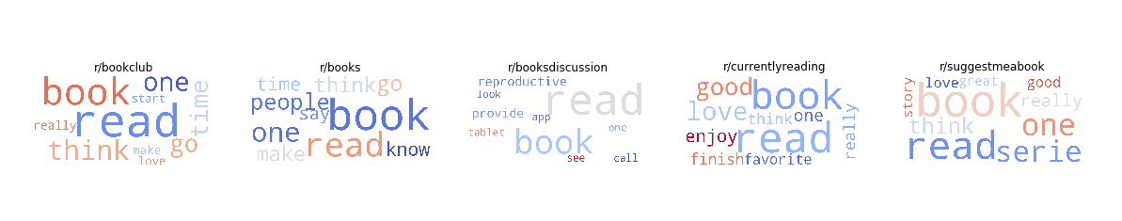
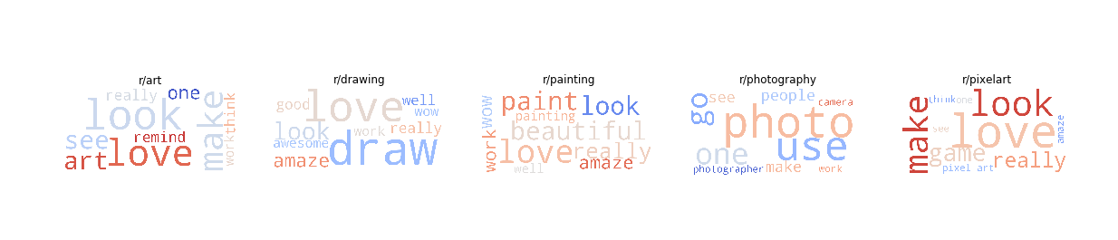
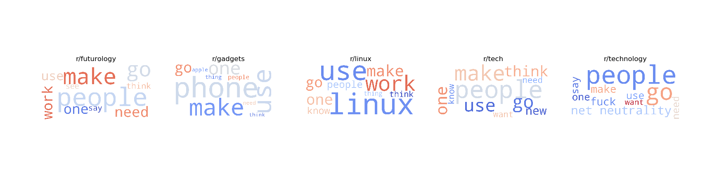

Slide 5
Thoughts
How are online communities distinguished by their language?
How is language similar within topics? Between topics? How does it vary within topics?
How can this similarity be measured and used?

Slide 6
Introduction to Document Clustering
Form of cluster analysis
Unsupervised learning
Form groups: items in a group more similar to each other than to items in other groups
Intuitive for observations with lots of features (including numeric features)
Class examples: log files from network traffic, medical data (cancer types)

Slide 7
How to represent documents
Documents (like articles, research papers, comment sections) have some superficial features: length, date, author, maybe manually assigned tags/categories
What about the actual content?
Terminology:
Corpus: a collection of documents
Lexicon/vocabulary: all of the words present in a corpus

Slide 8
Document Vectors
Let n be the number of terms in a corpus’ lexicon
Then each document can be represented as an 1xn vector
Columns/features: words in the lexicon
Values: presence/absence or count
We can vectorize each document in our corpus and combine to form the term-document matrix

Slide 9
Bag-of-Words Model
This approach, which ignores the ordering of words, is called bag-of-words
We can compute the similarity between any two document vectors
Most common measures:
Euclidian distance
Cosine similarity
Other measures:
Correlation
Jaccard Coefficient
Averaged Kullback-Leibler Divergence

Slide 10
Clustering Document Vectors
With these numeric representations of documents and relevant similarity measures, we can perform clustering
Can use any of the traditional algorithms:
K-Means
Agglomerative Hierarchical
DBSCAN and OPTICS
Affinity Propagation
Spectral Clustering

Slide 11
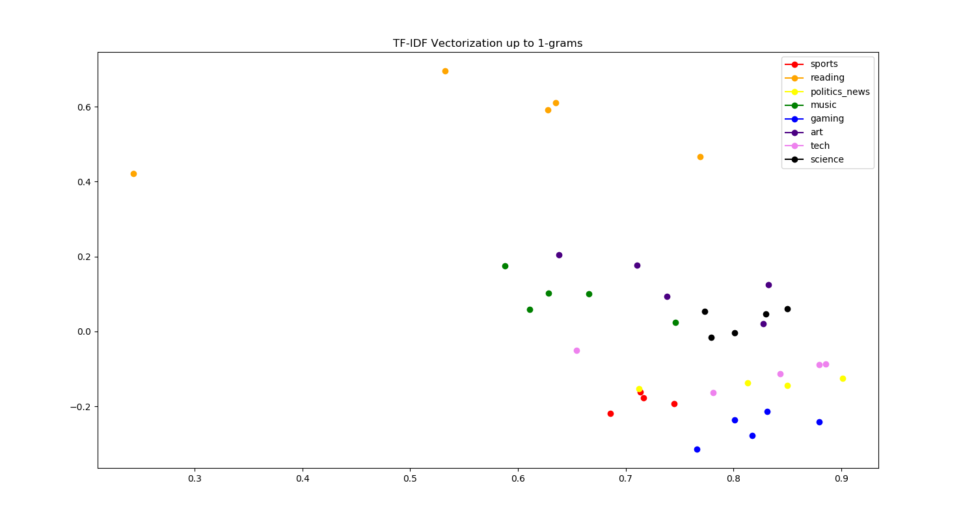
Visualizing Document Vectors in Two-Dimensions

Slide 12
One Small Problem
Curse of dimensionality: these matrixes are huge!
Must perform some decomposition: lose variance in data and have yet another hyperparameter to tune
Another approach: document embeddings

Slide 13
Document Embeddings
Is there another way to produce numeric representations of text?
Doc2Vec: “learn continuous distributed vector representations for pieces of text”
Many implementations exist
Can choose final dimension of vectors
Memory and specification concerns

Slide 14
Benefits of Document Embeddings
More concise numeric representations
Dimensions greatly reduced
Reduces computation time
Opens up more algorithms
Unsupervised algorithm
Can be trained on a specific corpus: can draw out differences specific to your dataset

Slide 15
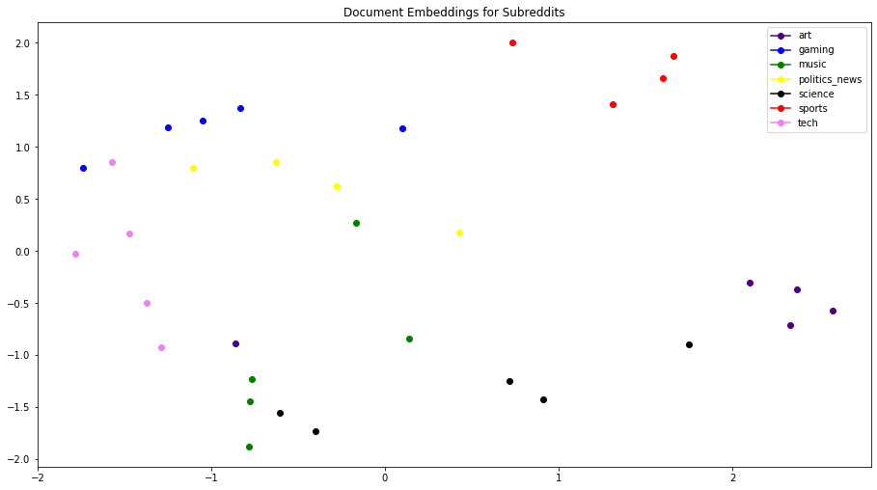
Visualizing Document Embeddings

Slide 16
Goals
This is a very interesting topic area
What if we were able to recommend subreddits or posts to users based on clustering?
Can we visualize subreddits and posts based on their numeric representations?

Slide 17
Design
Dataset & Models

Slide 18
A note on metrics
What did we notice from the previous two visualizations?
Lots of overlap → poor silhouette score
What if we had labels for each point?
Then we could use external measures to assess model accuracy
Completeness: observations in the same class are in the same cluster
Homogeneity: clusters contain observations that have the same class
V-Score: average of completeness and homogeneity

Slide 19
Which metrics should we use?
Do we necessarily want all observations from a class in the same cluster?
For subreddits that’s fine, but there are thousands of posts
Putting all posts in the same cluster would produce massive clusters which are not helpful
Main focus should be on maximizing homogeneity

Slide 20
Datasets
PRAW: an API for interacting with Reddit
Need an account and to set up a developer application
Since we need labels, collect by category
Compiled a list of 8 categories and ~5 subreddits in each category
Scraped top first- and second-level posts from 30 most upvoted posts on each sub

Slide 21
Dataset summary
~3000 comments for each subreddit
~100 comments per post
30 posts per sub
37 subs total
~111,000 comments total
Some don’t have that many comments: reading subs are pretty barren (no controversial opinions presented in there)

Slide 22
Models
Initially limited by tf-idf vectorization: k-means is the only one fast enough (mini-batch variant)
With embeddings, can add:
Hierarchical: Agglomerative Hierarchical
Density-based: DBSCAN & OPTICS
Other: Affinity Propagation & Spectral Clustering

Slide 23
Data Processing
Cleaning and Vectorization

Slide 24
Stop word removal
Not all words are important
A, the, it, him, her, and, but, because, etc.
Called stop words
NLTK: very useful natural language processing library in Python
For each post, stop words were removed

Slide 25
Lemmatization
How about different forms of the same word?
Pay, pays, paid, payment, etc.
Different approaches to reduce to base form: stemming and lemmatization
Stemming: “chopping off” endings
Lemmatization: uses morphological analysis
Approaches:
Lancaster Stemmer
Porter Stemmer
Lemmatizer (using WordNet)

Slide 26
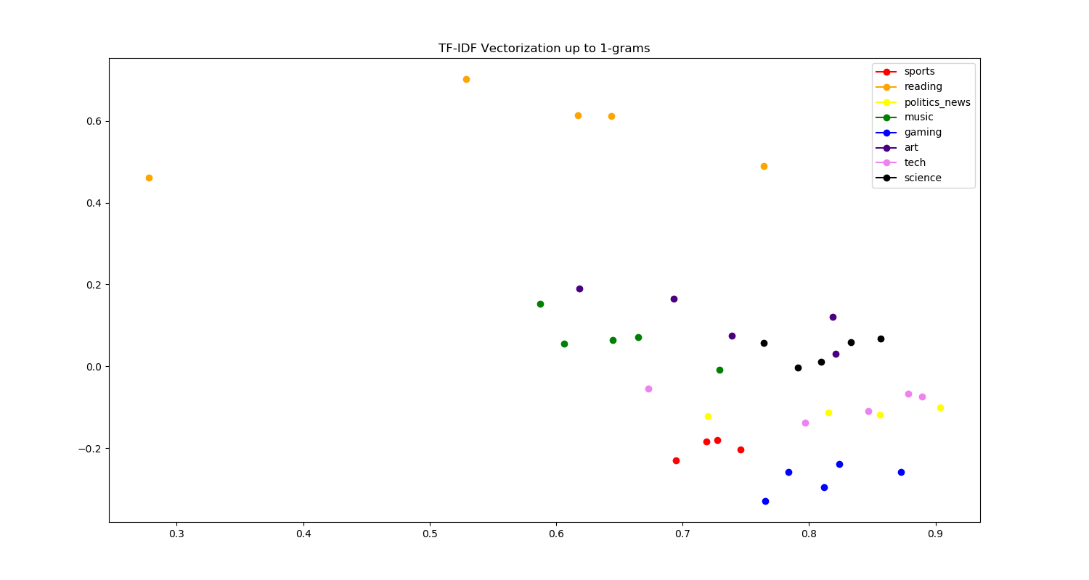
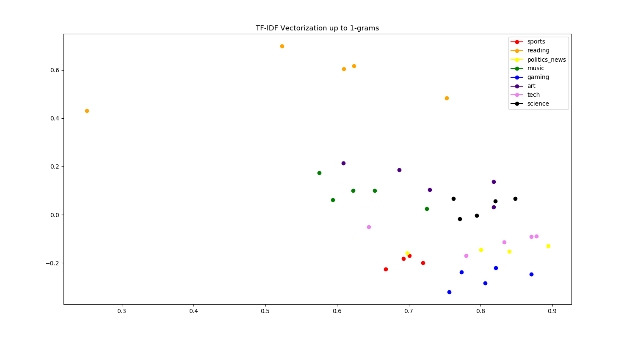
Stemming vs. Lemmatization Comparison
Lemmatizer
Lancaster Stemmer
Porter Stemmer

Slide 27
Which one to use?
No significant difference between them
However, lemmatization allows us to produce word clouds as an EDA step

Slide 28
Vectorization
As mentioned, two approaches to vectorization
TF-IDF Vectorizer (using SK-Learn implementation)
Word Embeddings (using Gensim implementation)
Trained embeddings on dataset (without reading subs included)
Treated dimension as a hyperparameter

Slide 29
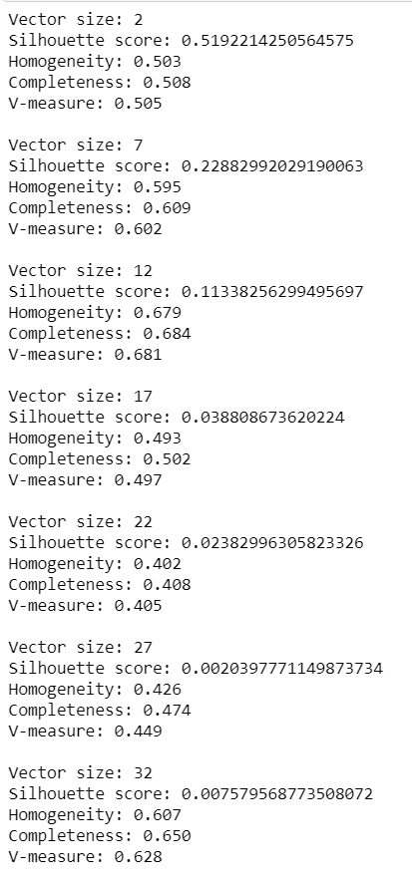
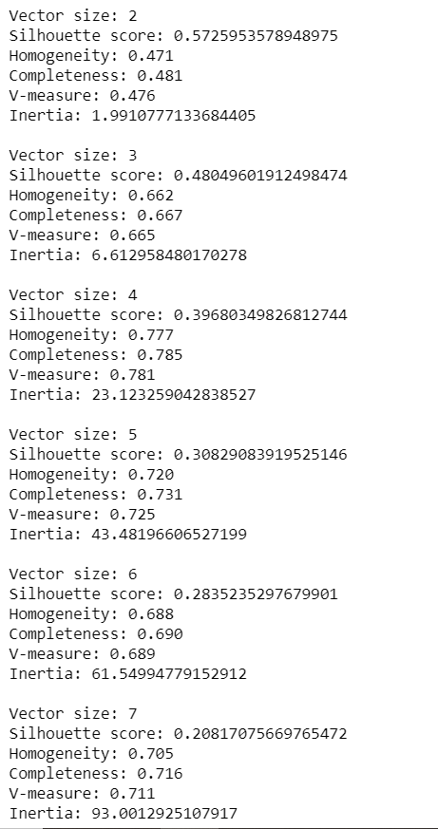
Training Document Embeddings
Ideal range
Maximizes homogeneity, keeps some silhouette score

Slide 30
Experiments
Clustering Algorithms, TF-IDF Vectors vs. Embeddings

Slide 31
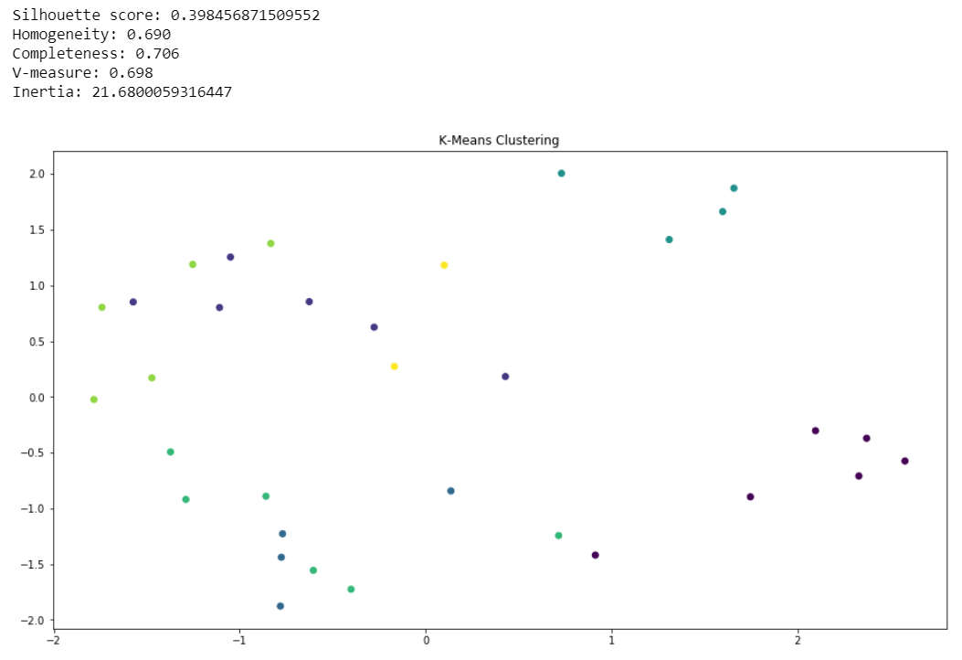
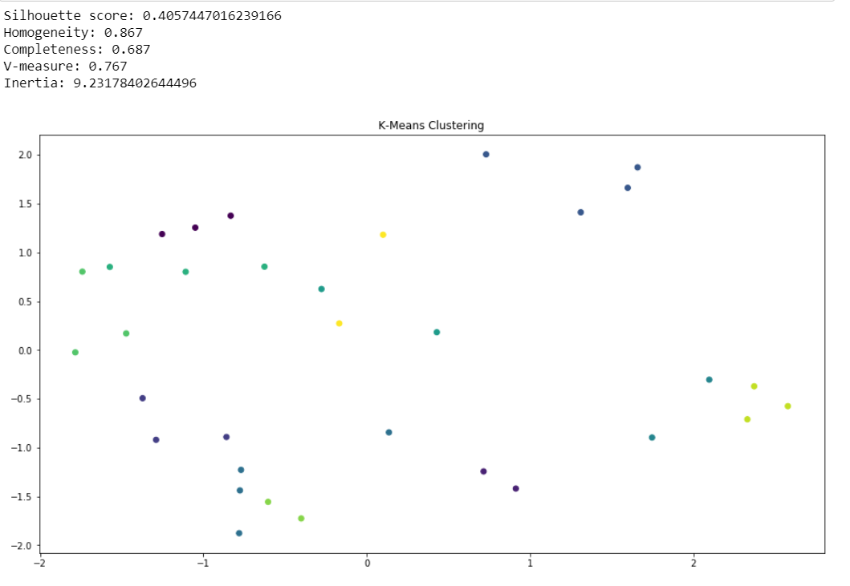
K-Means
Standard process: find ideal k value, cluster, view results
Have a k already from number of categories
Still search for ideal value

Slide 32
Observations
Increasing number of clusters can improve homogeneity
Overlapping clusters → low silhouette score
Worthwhile to search for ideal number of clusters

Slide 33
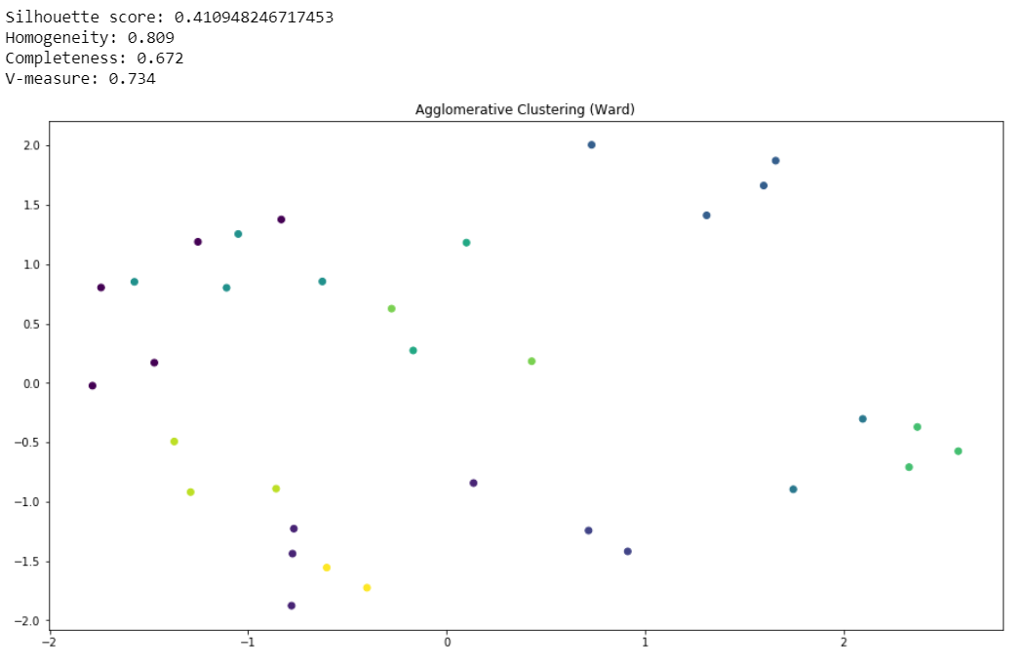
Agglomerative Hierarchical with 11 clusters

Slide 34
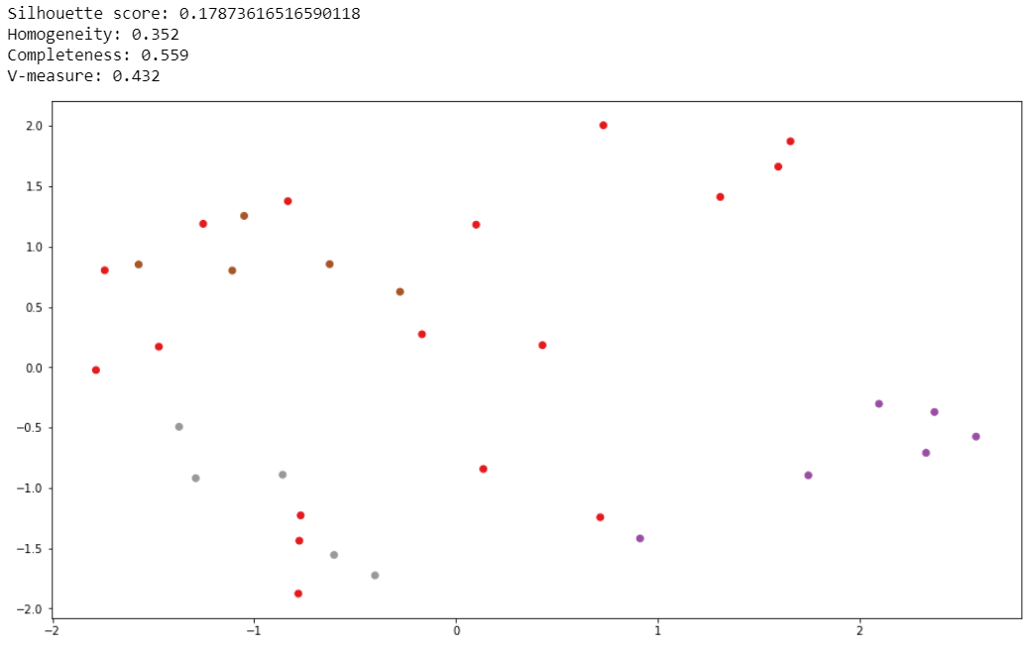
DBSCAN

Slide 35
Observations
Density-based algorithms perform very poorly
Have a tendency to make a few very large clusters
Brings down homogeneity
Not a good fit for this dataset

Slide 36
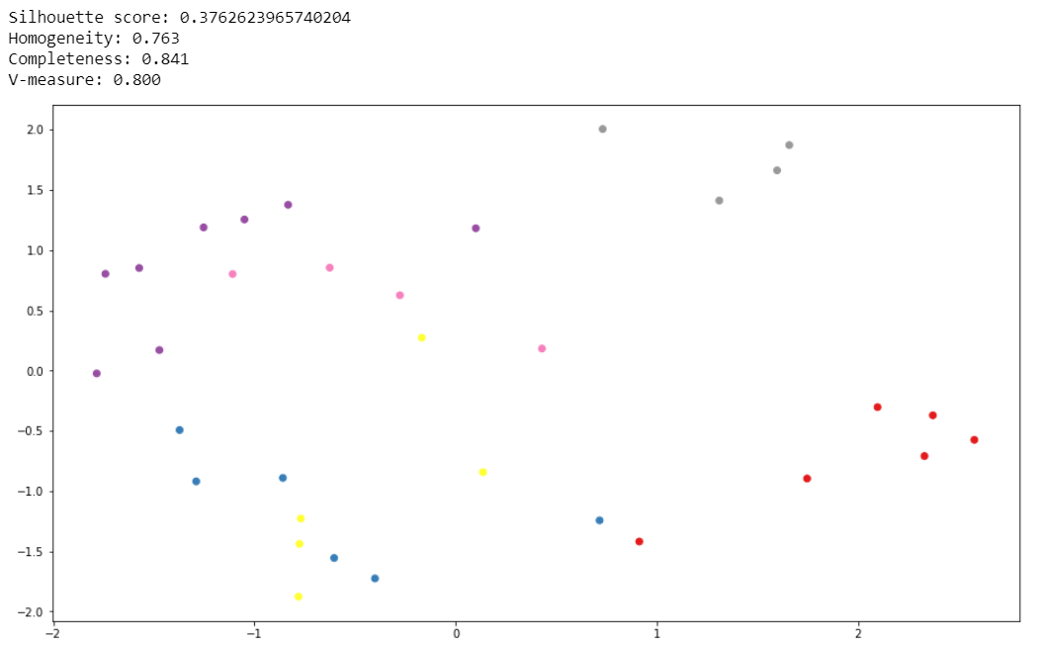
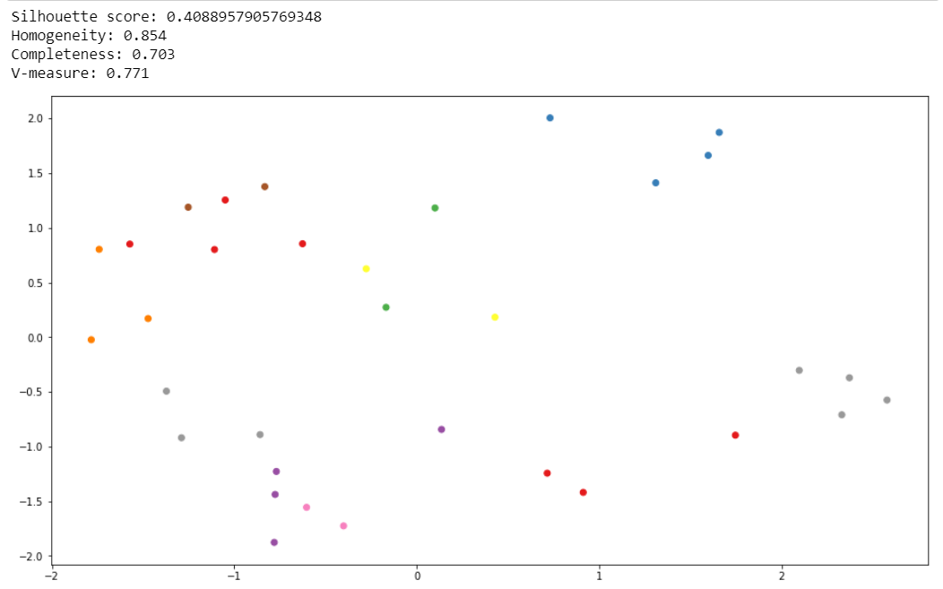
Additional algorithms
Affinity Propagation
Spectral Clustering

Slide 37
Affinity Propagation and Spectral Clustering
Affinity propagation: matrix-based algorithm focused on finding “examplars” in the dataset and using them to calculate boundaries
Spectral clustering: uses decomposition to cluster in lower dimensions
Spectral decomposition: eigenvalues of a similarity matrix

Slide 38
Other experiments
Using the TF-IDF vectorization
Silhouette 0.5
Homogeneity 0.85
Using posts instead of subreddits
Same overall process, much more difficult
Can view at: https://github.com/jonwiseman/DS300/blob/master/Notebooks/Post%20Clustering.ipynb

Slide 39
Results
Application

Slide 40
Sanity check
Check closest subreddits using Gensim’s built-in most_similar() method
A sample subreddit: r/pcgaming
5 closest subreddits:
r/xboxone
r/games
r/gadgets
r/linux
r/gaming
All make sense, so our embeddings are reasonable

Slide 41
Using K-Means
r/pcgaming is clustered with:
r/gadgets
r/linux
Decent, but not all that useful (right?)

Slide 42
Using Agglomerative Clustering
r/pcgaming is clustered with:
r/games
r/xboxone
r/gadgets
r/linux
Bigger cluster, more gaming subreddits

Slide 43
Using Affinity Propagation
r/pcgaming is clustered with:
r/games
r/gaming
r/ps4
r/xboxone
r/gadgets
r/linux
r/technology
All reasonable recommendations; much bigger cluster

Slide 44
Using Spectral Clustering
r/pcgaming is clustered with
r/gadgets
r/linux
Very small cluster, very similar to K-Means

Slide 45
Overall
Agglomerative and Affinity Propagation give best results
All give reasonable clusterings, nothing unexpected

Slide 46
Conclusion
What can we do better?

Slide 47
Summary
Document clustering is an interesting area with diverse applications
Interaction of multiple parts: data collection, language cleaning, model creation (and neural network training)
Need a complete understanding of each part in order to create accurate representations of documents

Slide 48
Project Results
Were able to produce a rudimentary recommendation system using document clustering
Also able to visualize subreddits’ relationships
Varying cluster sizes: small to large
Always had overlapping clusters: need larger dataset to bring out differences between subreddits
TF-IDF model actually had better results, but is limited due to size

Slide 49
Dataset Improvements
To really bring out the differences in text, we should collect a bigger dataset
But scraping is expensive: API requests are limited, it’s hard to access posts, and there are a lot of cleaning steps
Which posts should we collect?
Top posts of all time tend to be highly focused on big events/news stories
Not every post has enough comments to really contribute

Slide 50
Dataset Improvements (cont.)
Which subreddits to collect?
Only the most active ones?
Putting a threshold on the minimum number of comments in order to be clustered
Sampling to get more representative comments
Size becomes an issue (like in next slide)

Slide 51
A potential dataset
https://www.kaggle.com/reddit/reddit-comments-may-2015
All comments on Reddit in May 2015, scraped using a similar process
Stored in an SQLite file
~20 GB compressed, ~40 GB to use
Size and access issues

Slide 52
Method Improvements
Training embeddings was done very clumsily: treated as a hyperparameter for a K-Means model (without altering anything else in the model)
Need to do more research into the Doc2Vec algorithm and how it works
For TF-IDF vectorization, need a better understanding of how to perform dimensionality reduction without losing too much of data’s variance

Slide 53
Method Improvements (cont.)
How to hand-label subreddits into categories
Very subjective
Huge influence on which subreddits are collected
At its heart, clustering is an unsupervised problem
Need to collect data for more subreddits and perform truly unsupervised clustering

Slide 54
Questions?

